Slide 1
IDENTIFICAÇÃO DE DEPRESSÃO A PARTIR DE ANÁLISE DE TEXTOS

Slide 2

Integrantes
Adriana Maria Padilla – 15.00792-8
Felipe Sarmento Araújo – 15.02177-7
Fernanda Tanajura Piva – 12.02643-3
Vinícius Lago Fernandes – 14.01293-6
Professor Orientador: Tiago Sanches

Slide 3
Histórico

Slide 4
322 milhões de pessoas
Com depressão ao redor do mundo
788 mil pessoas
Se suicidam por ano, em média
2ª maior causa de morte
Para pessoas entre 15-29 anos
Dados: OMS(2016)

Slide 5
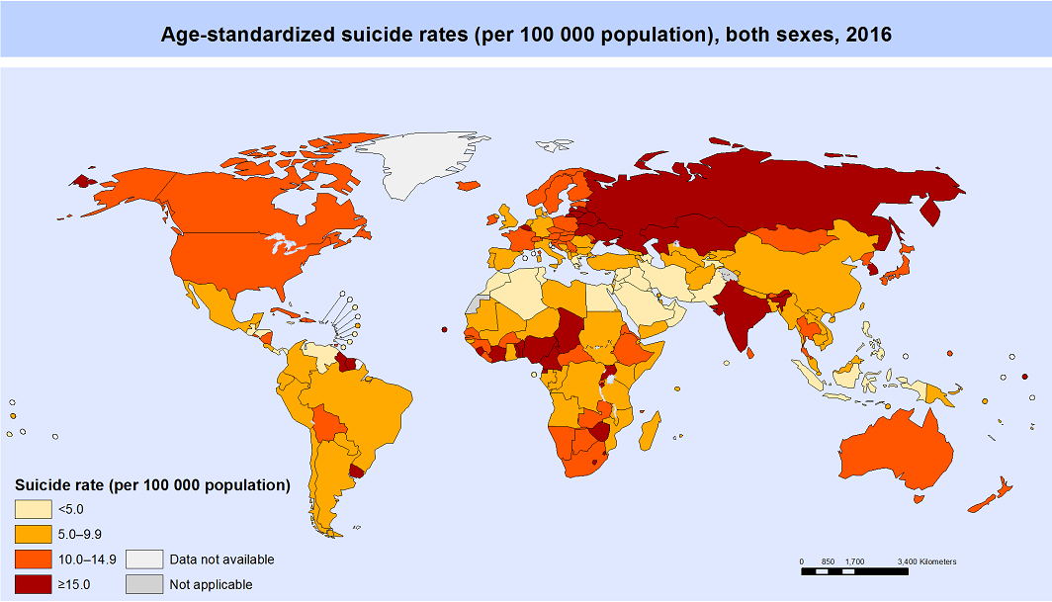
our office

Slide 6
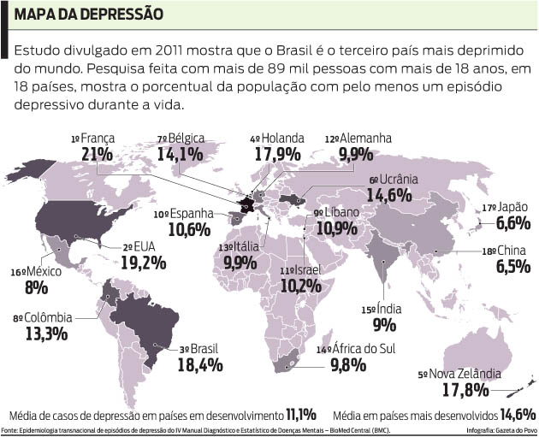

Slide 7
Motivação

Slide 8
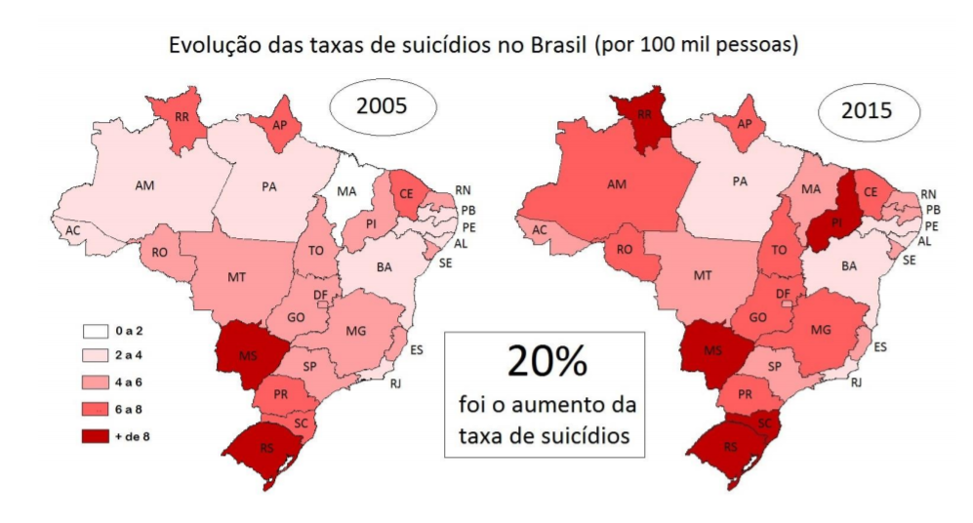
our office

Slide 9
5,8% da população Brasileira
Sofre de depressão, maior indice da América Latina, 8º no mundo
11433 pessoas
Se suicidaram em 2016
Aumento de 30%
Nos últimos 25 anos
Dados: OMS(2016) e Ministério da Saúde

Slide 10
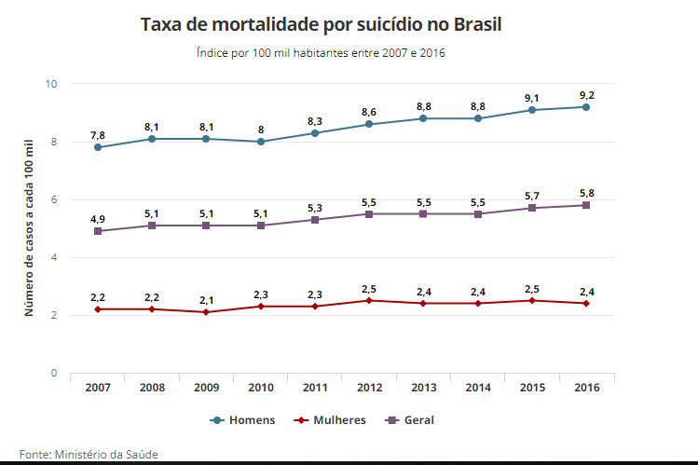

Slide 11
Referências

Slide 12
Uso Potencial de ferramentas de classificação de texto como assinaturas de comportamentos suicidas: um estudo de prova de conceito usando os escritos pessoais de Virginia Wolf.
Gabriela de Ávilla

Slide 13
Depression detection using emotion artificial intelligence
Mandar Deshpande, Vignesh Rao

Slide 14
A Multilevel Predictive Model for Detecting Social Network Users with Depression
Akkapon Wongkoblab, Miguel A. Vadillo, Vasa Curcin

Slide 15
Metodologia

Slide 16
Texto a ser análisado
Pré-processamento
Contagem de Palavras específicas
Análise de sentimentos
Outros
Rede Neural
Resultados

Slide 18
Cronograma

Slide 19
Obrigado!
Perguntas?

Slide 20
INSTRUCTIONS FOR USE
EDIT IN GOOGLE SLIDES
Click on the button under the presentation preview that says "Use as Google Slides Theme".
You will get a copy of this document on your Google Drive and will be able to edit, add or delete slides.
You have to be signed in to your Google account.
EDIT IN POWERPOINT®
Click on the button under the presentation preview that says "Download as PowerPoint template". You will get a .pptx file that you can edit in PowerPoint.
Remember to download and install the fonts used in this presentation (you’ll find the links to the font files needed in the Presentation design slide)
More info on how to use this template at www.slidescarnival.com/help-use-presentation-template
This template is free to use under Creative Commons Attribution license. You can keep the Credits slide or mention SlidesCarnival and other resources used in a slide footer.

Slide 21
Texto a ser análisado
Pré-processamento
Pré-processamento
Pré-processamento
Contagem de Palavras:
Outros a serem definidos
Análise de sentimentos
Pronomes
Tristeza
Absolutismo
Tristeza
Alegria
Tristeza
Rede Neural
Resultados

Slide 22
Quotations are commonly printed as a means of inspiration and to invoke philosophical thoughts from the reader.

Slide 23
THIS IS A SLIDE TITLE
Here you have a list of items
And some text
But remember not to overload your slides with content
Your audience will listen to you or read the content, but won’t do both.

Slide 24
BIG CONCEPT
Bring the attention of your audience over a key concept using icons or illustrations

Slide 25
YOU CAN ALSO SPLIT YOUR CONTENT
White
Is the color of milk and fresh snow, the color produced by the combination of all the colors of the visible spectrum.
Black
Is the color of coal, ebony, and of outer space. It is the darkest color, the result of the absence of or complete absorption of light.

Slide 26
IN TWO OR THREE COLUMNS
Yellow
Is the color of gold, butter and ripe lemons. In the spectrum of visible light, yellow is found between green and orange.
Blue
Is the colour of the clear sky and the deep sea. It is located between violet and green on the optical spectrum.
Red
Is the color of blood, and because of this it has historically been associated with sacrifice, danger and courage.

Slide 27
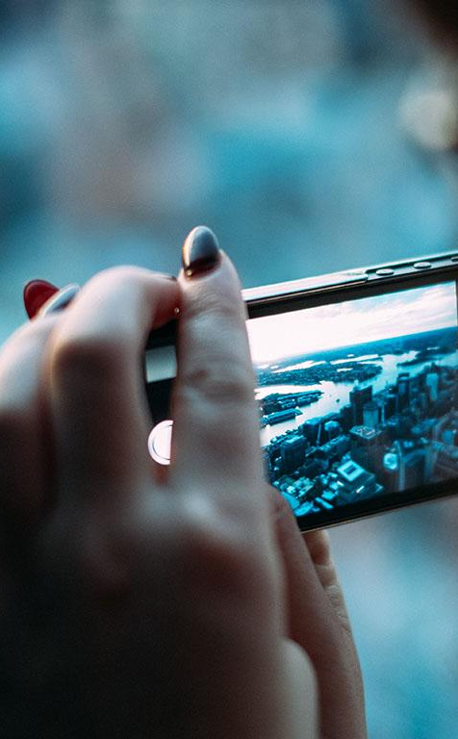
A PICTURE IS WORTH A THOUSAND WORDS
A complex idea can be conveyed with just a single still image, namely making it possible to absorb large amounts of data quickly.

Slide 28

Want big impact?
Use big image.

Slide 29
USE CHARTS TO EXPLAIN YOUR IDEAS
White
Gray
Black

Slide 30
AND TABLES TO COMPARE DATA
 | A | B | C
Yellow | 10 | 20 | 7
Blue | 30 | 15 | 10
Orange | 5 | 24 | 16

Slide 31
MAPS
our office

Slide 32
89,526,124
Whoa! That’s a big number, aren’t you proud?

Slide 33
89,526,124$
185,244 users
100%
That’s a lot of money
And a lot of users
Total success!

Slide 34
LET’S REVIEW SOME CONCEPTS
Yellow
Is the color of gold, butter and ripe lemons. In the spectrum of visible light, yellow is found between green and orange.
Blue
Is the colour of the clear sky and the deep sea. It is located between violet and green on the optical spectrum.
Red
Is the color of blood, and because of this it has historically been associated with sacrifice, danger and courage.
Yellow
Is the color of gold, butter and ripe lemons. In the spectrum of visible light, yellow is found between green and orange.
Blue
Is the colour of the clear sky and the deep sea. It is located between violet and green on the optical spectrum.
Red
Is the color of blood, and because of this it has historically been associated with sacrifice, danger and courage.

Slide 35
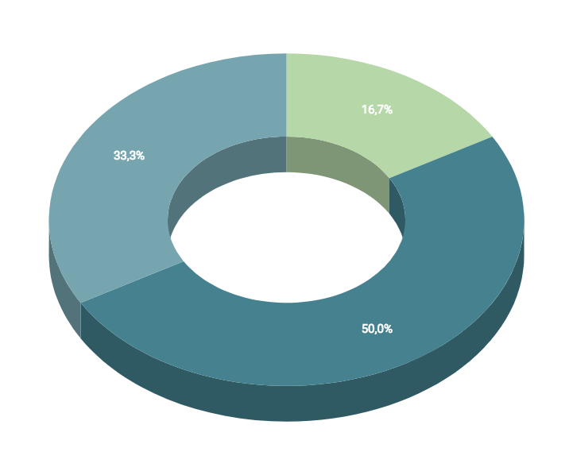
You can insert graphs from Google Sheets

Slide 36
ANDROID PROJECT
Show and explain your web, app or software projects using these gadget templates.
Place your screenshot here

Slide 37
iPHONE PROJECT
Show and explain your web, app or software projects using these gadget templates.
Place your screenshot here

Slide 38
TABLET PROJECT
Show and explain your web, app or software projects using these gadget templates.
Place your screenshot here

Slide 39
DESKTOP PROJECT
Show and explain your web, app or software projects using these gadget templates.
Place your screenshot here

Slide 40
CREDITS
Special thanks to all the people who made and released these awesome resources for free:
Presentation template by SlidesCarnival
Photographs by Unsplash

Slide 41
PRESENTATION DESIGN
This presentation uses the following typographies and colors:
Titles: Dosis
Body copy: Titillium Web
You can download the fonts on these pages:
http://www.impallari.com/dosis
http://www.campivisivi.net/titillium/
Pastel green #d3ebd5 · Green #80bfb7 · Teal #0b87a1 · Navy #01597f · Dark navy #003b55
You don’t need to keep this slide in your presentation. It’s only here to serve you as a design guide if you need to create new slides or download the fonts to edit the presentation in PowerPoint®

Slide 42
SlidesCarnival icons are editable shapes.
This means that you can:
Resize them without losing quality.
Change fill color and opacity.
Change line color, width and style.
Isn’t that nice? :)
Examples:

Slide 43
😉
Now you can use any emoji as an icon!
And of course it resizes without losing quality and you can change the color.
How? Follow Google instructions https://twitter.com/googledocs/status/730087240156643328
✋👆👉👍👤👦👧👨👩👪💃🏃💑❤😂😉😋😒😭👶😸🐟🍒🍔💣📌📖🔨🎃🎈🎨🏈🏰🌏🔌🔑 and many more...

